Slide 1
GRIT Monthly
Prepared by
RadiaBeam Technologies, LLC.
8/16/2024
GRIT DARPA BAA Contract # HR001120C0072
and SBIR Awards # W912CG22C0032, W912CG22C0033

Slide 2
Topics to be Covered
Runtime Optimization (Andrew Fisher)
Diagnostic Upgrade
Laser Status
Next Steps

Slide 3
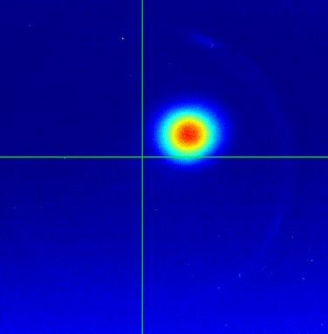
Photohybrid
Increased Charge
Reduced losses on UV transport
Adding second ICT after structures
Well-defined operating phase

Slide 4
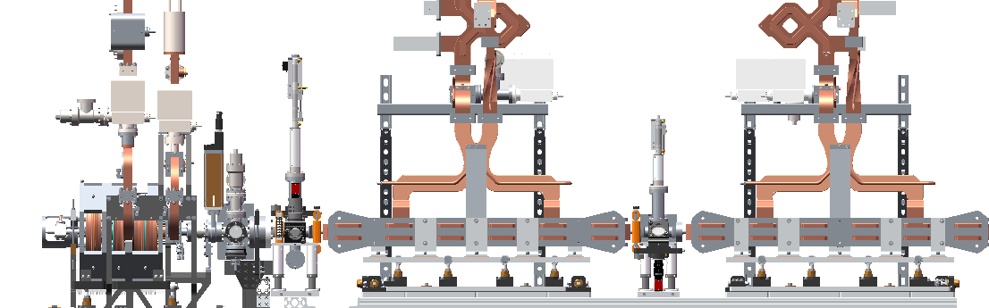
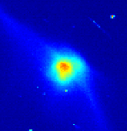
Linac Structures
Beam alignment and tuning
Similar settings day to day
Fast alignment procedure
Structure tuning
Adjust phase/frequency to maximize energy
Coarse: deflection from steering magnet
Fine: dump dipole current
Steering 1
Steering 2
Steering 3

Slide 5
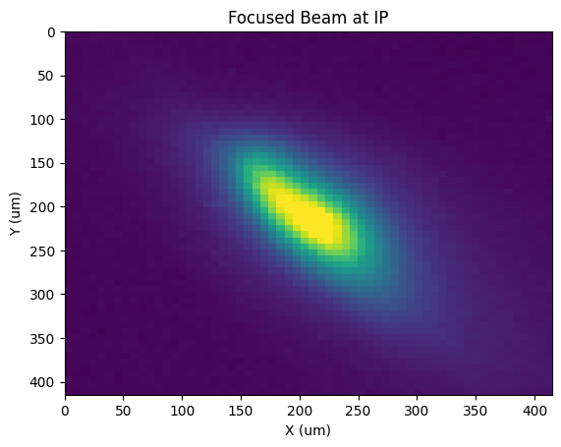

Beam Focusing
50 um rms spotsize at interaction point (IP)
7 um/pixel calibration
Targeting 10 um
Tune with photohybrid correctors
Screen Alignment
Motorized IP screen
Alignment laser (long term benefits)

Slide 6
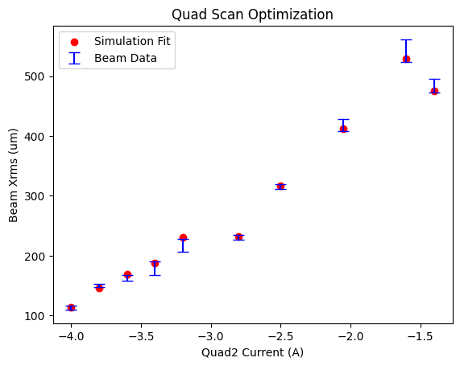
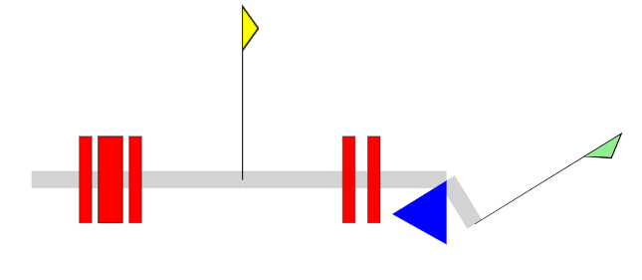
Quad Scan Measurement
Quad Scan
Save spotsizes at various focusing
Optimize beam matrix to minimize error between simulation and data
Use simulation as guide
Matrix model in Elegant and Python
Initial beam matrix from optimization
Quads will be operated up to 10A.
Weak focusing
Strong focusing
Start
(Linac exit)
Triplet IP Doublet Dump

Slide 7
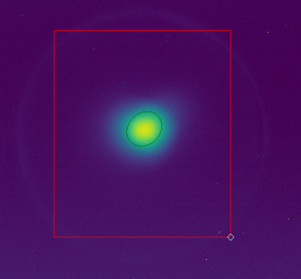
Data Collection
Saving images and beamline settings
Image statistics, charge, steering, quads, etc.
Manual measurements
Utilize scripts to automate measurements
Quad scan, steering raster scans
Faster, repeatable
ROI
Gaussian Fit

Slide 8
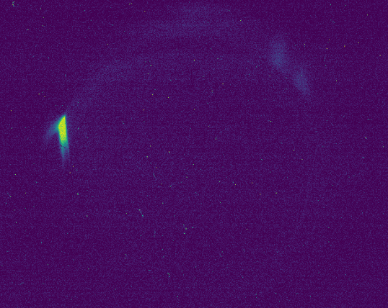
Beam Dump
Beam found at 146 amps on dipole
Corresponds to ~90 MeV
Correctly manipulated by dipole and quads
Adding steering
Align after beamline upgrades
Fix dump to floor
Energy Axis

Slide 9
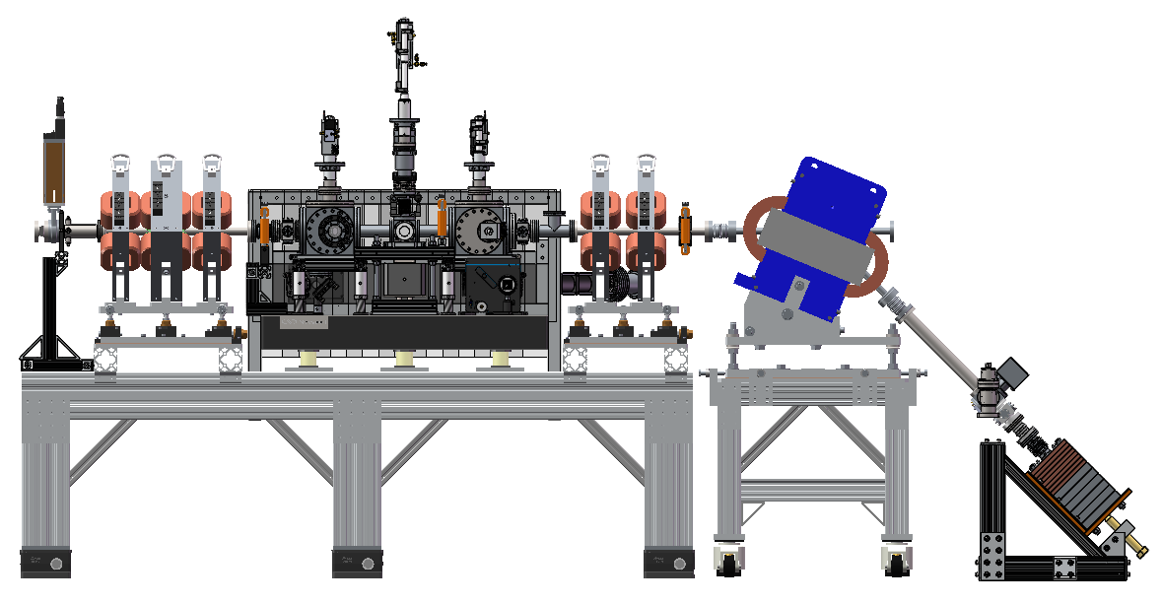
Current Beamline
6”x4.5” ZLR
Remove and replace with 6”x2.75” ZLR from upstream
Ion Pump
Replace Tee with cube and 1/2” OTR, Move after Doublet
Stripline BPM
Replace with 1” OTR
½” YAG
Remove YAG (use OTR), Move to before Dump Dipole
Replace with new 1” YAG ASM
Button BPM
Replace with ICT
Button BPM
Replace with Stripline BPM
6”x2.75” ZLR
Remove and move to downstream ZLR position

Slide 10
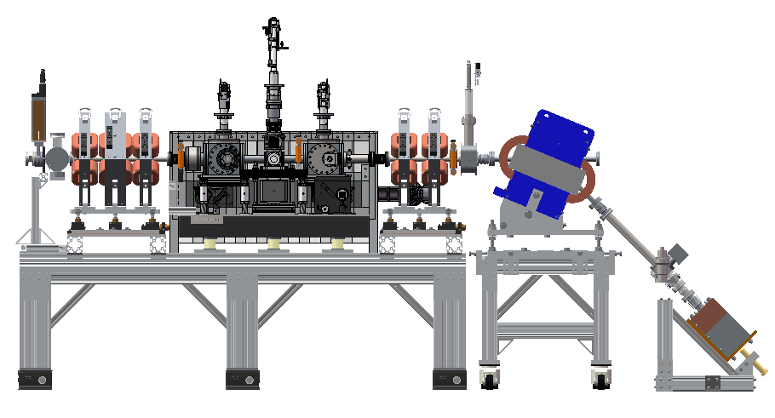
Proposed Solution
1” OTR
Custom cross from previous emittance slit assembly
Add YAG screen
½” OTR becomes ½” YAG
4.5”x6” Adapter
2” Long, Metric Studs
Stripline BPM
Taken from upstream, Remove Button BPM
2.75” CF Cube, ½” OTR
Ion Pump moved here, ½” Setup Moved from after Dump Dipole
2.75” CF Cube, 1” YAG
New Assembly
2.75” CF Nipple
18.25” Long
2.75” CF Nipple
13.85” Long
ICT
Add 4.5” to 2.75” ZLR, Metric Studs

Slide 11
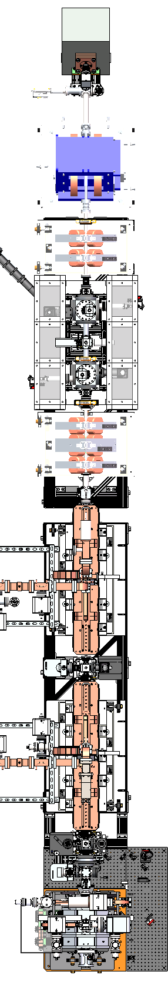
Reference axis laser
Experiments have shown we were missing the accelerator’s axis position
We are installing a diode laser at the most upstream camera position
Using the back of the mirror used to visualize the cathode
Propagating the diode laser down the most downstream OTR
Diode laser input
Top view of the accelerator
Diode output on
new OTR camera

Slide 12
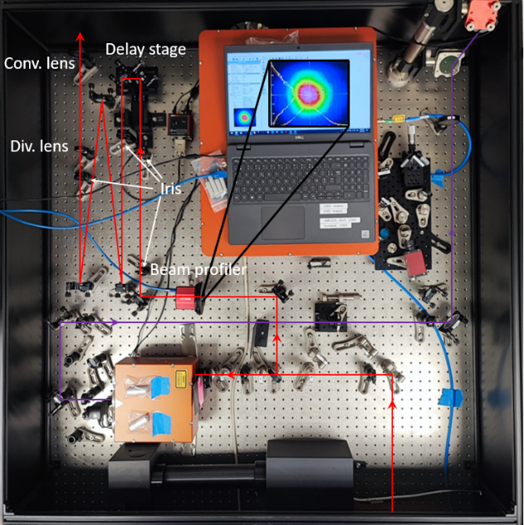
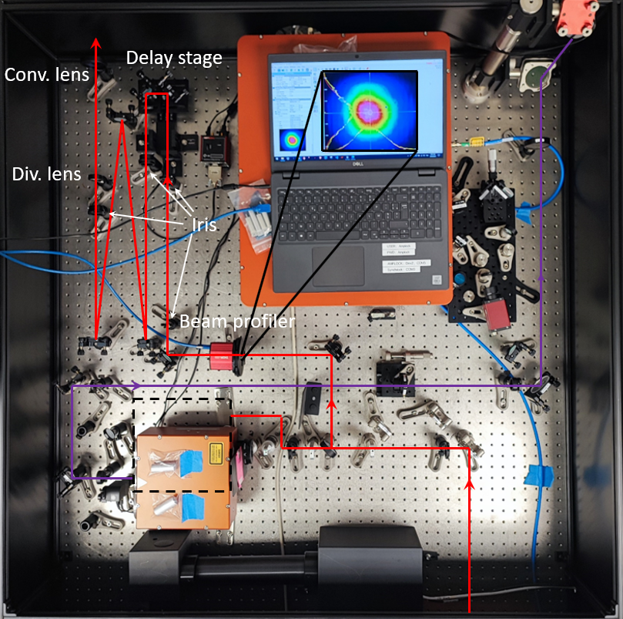
IR laser
After recent AC shut down and constant accelerator’s operation, laser work on IR was limited
The UV beamline and IR beamline setup from Amplitude has been modified so their alignment can be tuned individually
We re-aligned the laser in the cleanroom after the AC shutdown and propagated it to the bunker
Currently propagating the IP to propagate IR laser through the IP pinhole during shutdown

Slide 13
Next Steps
Install steering and diagnostics (ICT and screens)
Fine tune structures with dump dipole
Optimize spotsize and transport through pinhole
Run for light

